Slide 1
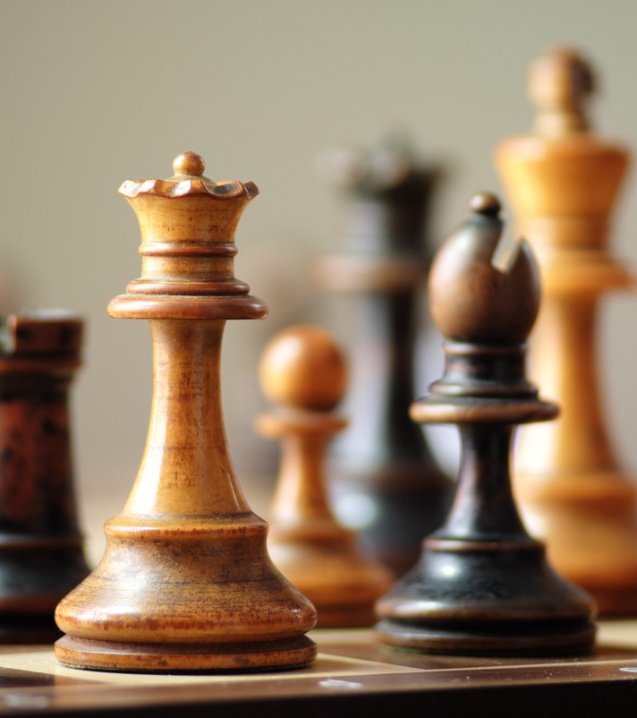
Chess brains
Made using Socket.io

Slide 2
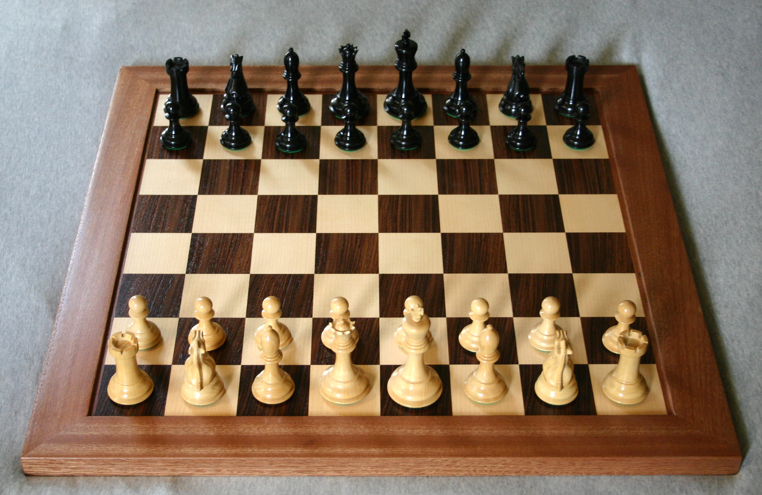
ABSTRACT
ABSTRACT
chess, one of the oldest and most popular board games, played by two opponents on a checkered board with specially designed pieces of contrasting colours, commonly white and black. White moves first, after which the players alternate turns in accordance with fixed rules, each player attempting to force the opponent’s principal piece, the King, into checkmate—a position where it is unable to avoid capture.

Slide 3
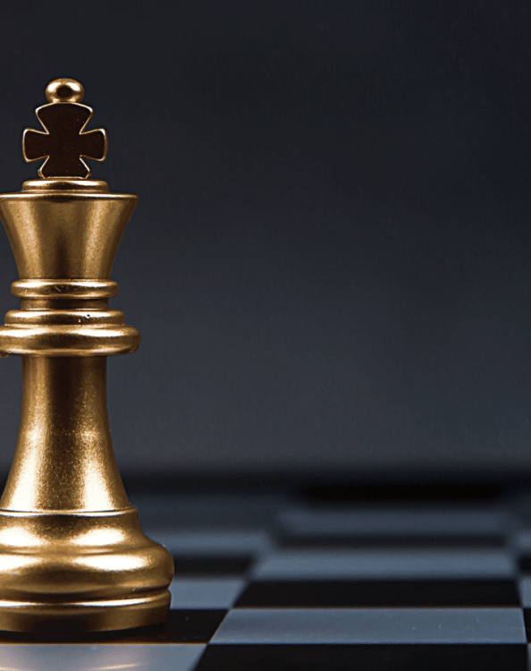
INTRODUCTION
INTRODUCTION
Chess first appeared in India about the 6th century AD and by the 10th century had spread from Asia to the Middle East and Europe. Since at least the 15th century, chess has been known as the “royal game” because of its popularity among the nobility. Rules and set design slowly evolved until both reached today’s standard in the early 19th century. Once an intellectual diversion favoured by the upper classes, chess went through an explosive growth in interest during the 20th century as professional and state-sponsored players competed for an officially recognized world championship title and increasingly lucrative tournament prizes. Organized chess tournaments, postal correspondence games, and Internet chess now attract men, women, and children around the world.

Slide 4
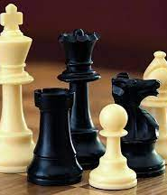
Problem statement
The problem is to design a Chess Game using Object Oriented Principles. The main classes that can be used are: 1. Spot: A spot represents one block of the 8x8 grid and an optional piece. 2. Piece: The basic building block of the system, every piece will be placed on a spot. Piece class is an abstract class. The extended classes (Pawn, King, Queen, Rook, Knight, Bishop) implements the abstracted operations. 3. Board: Board is an 8x8 set of boxes containing all active chess pieces. 4. Player: Player class represents one of the participants playing the game. 5. Move: Represents a game move, containing the starting and ending spot. The Move class will also keep track of the player who made the move. 6. Game: This class controls the flow of a game. It keeps track of all the game moves, which player has the current turn, and the final result of the game.

Slide 5
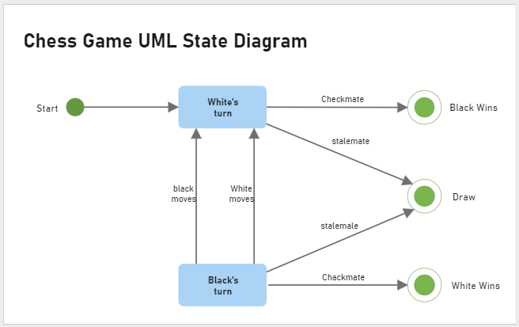
Problem walkthrough

Slide 6
Technologies used
And how we solved the problem?
We used ReactJS, one of the best JavaScript frameworks out in the world to create the best responsive website and integrated Socket.io, one of the best socket libraries, to make this project possible. node js is a server side language and socket.io provides bidirectional communication. We will first create an HTTP server that will be up to handle each coming request and hold it until the client requests to leave it.

Slide 7

Future scope
In the near future, we intend to incorporate a variety of features such as real-time Multiplayer game and hosting the website officially.

Slide 8
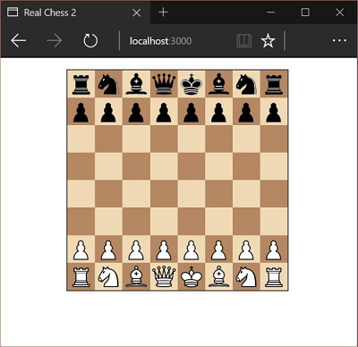
conclusion
Hence we have successfully completed the development of chess game application

Slide 9

References
https://www.pexels.com/
https://boxicons.com/
https://www.google.com/
https://www.wikipedia.org/

Slide 10
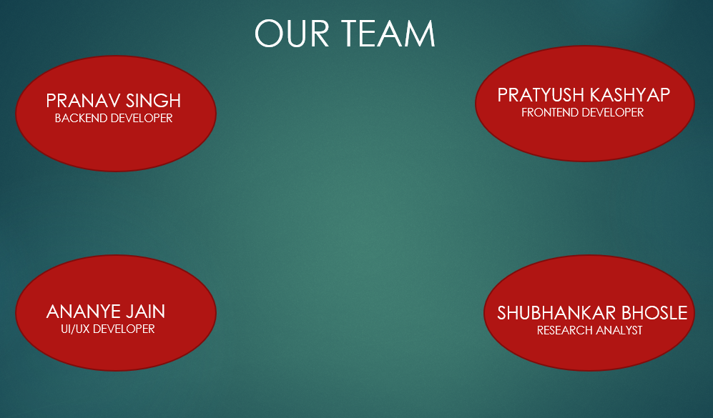
LightHouse

